Slide 1
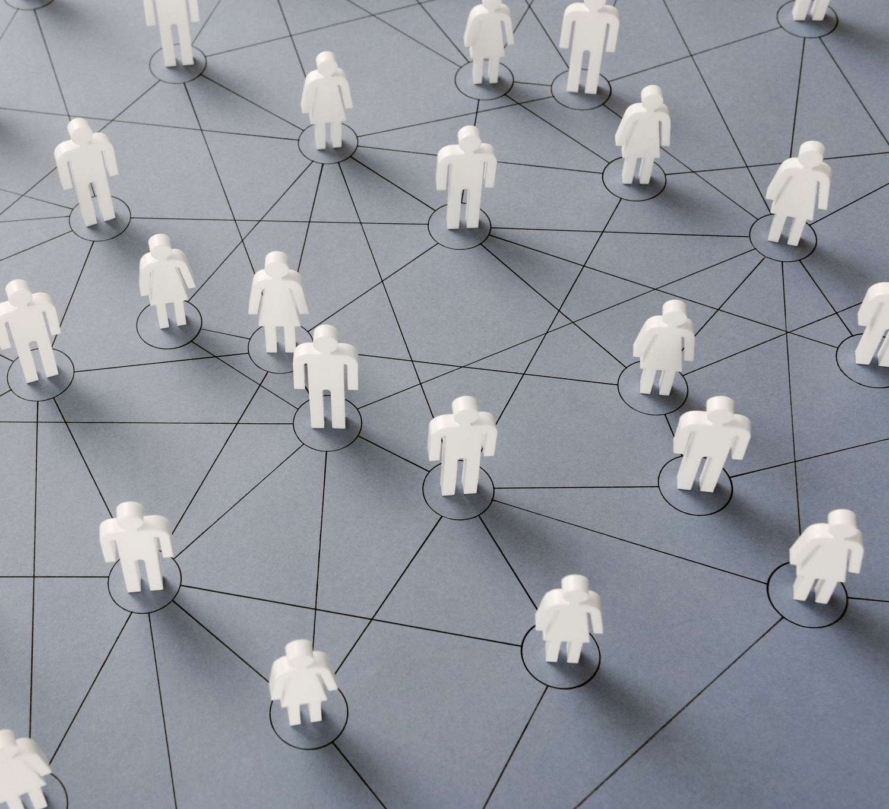
Community detection in social media
Name: Mkhonto Hendry mike
Student number: 221026908
Supervisor: Dr vodka

Slide 2
Agenda
Introduction
Methodology
Result and Discussion
Conclusion
References

Slide 3
Introduction
What is community detection ?
What is the importance of community ?
Problem statement
Aim and objective
Community Detection application

Slide 4
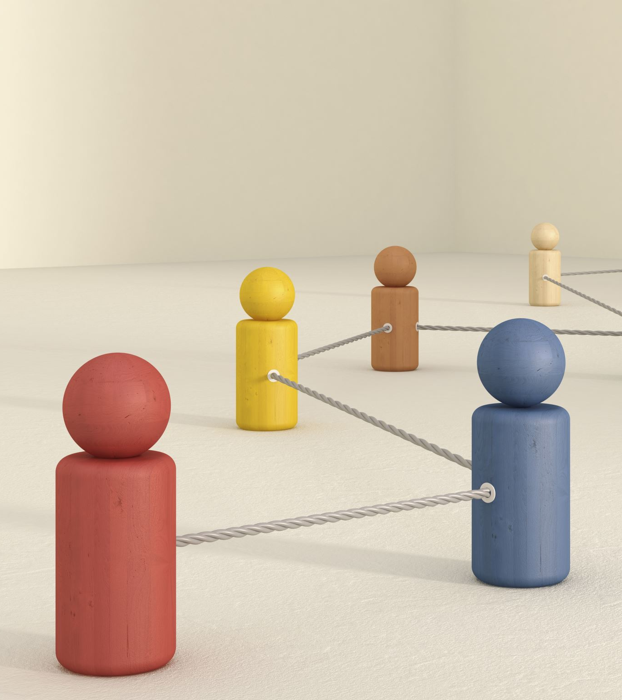
What is community ?
Subset of nodes of V such that the are more edges inside the community (real world network such as internet, social network , etc.)
Are Entities which interact with one another in a mutual relationship which may have things in common or activities.
By Understanding these groups helps us see how people or things are connected and how they interact with one another.

Slide 5
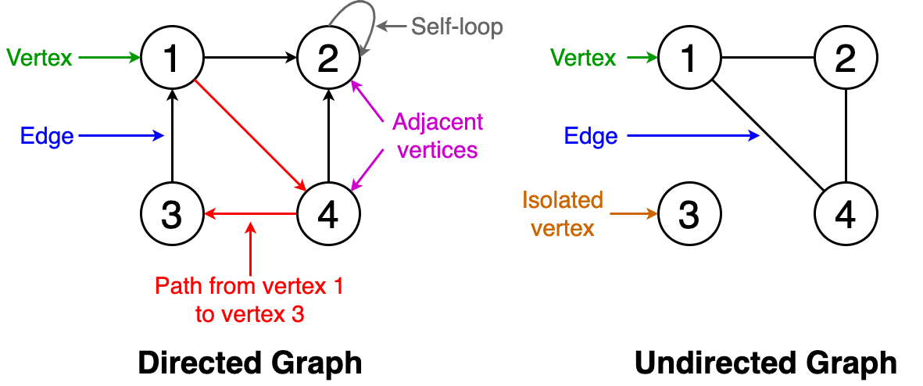
What is graph theory ?
Is a mathematical framework used to study the structure and properties of networks or graph.
Graph G=(V,E) is a collection of nodes(vertex) that connected by edges. Graph may be directed or undirected.
Nodes( Vertices) is the interaction between two edges, nodes represent entities
Edges(E) represent connection or relationship between nodes(vertices)

Slide 6
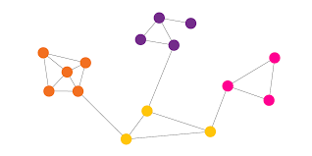
Graph coloring
Graph coloring is a method to assign colors to the vertices of a graph so that no two adjacent vertices have the same color.
Some graph coloring problems are:
Vertex coloring: A way of coloring the vertices of a graph so that no two adjacent vertices share the same color
Edge coloring : A method of assigning a color to each edges so that no two adjacent edges have the same color.
Chromatic Number :
Is the minimum number of colors required to color a graph

Slide 7
What is community detection?
is the process of identifying distinct groups or clusters of nodes within a network. These groups, known as communities, are characterized by a higher density of connections among their members compared to connections with nodes outside the group
Why we use community detection ?
To capture network dynamic
Reveal social structure( subgroup or community of interest)
Link prediction

Slide 8
Community detection application
1. Social Network Analysis(SNA)
Community detection is widely used in SNA to identify group of individuals with
similar interest.
2. Recommendation System(RD)
Community detection can be applied to RD to identify communities of users with
similar preferences

Slide 9
Background
Graph theory was invented by Leonhard Euler
According to (J Carrington and Scotts, 2011:1),state that the concept of social networking has been around since the 1930s, but it was under the research of social network analysis (SNA) discovered in the early 1980s and 1990s social science field space (Wetheral,1998)
Community detection is almost inter-changeably used with graph clustering (Fortunato 2010; Schaeffer 2007)
According to Statista “ social media users have increased by over 1.52 billion to 4.59 billion people increasing the number of publicity available to social network data on the internet”(2023).

Slide 10
Problem statement
We want to detect how many communities were created and how does it affect the SNA
To find the best community detection algorithms that works better between Spectral-clustering, Girvan-Newman and Louvain algorithm.

Slide 11
Literature Review
A wide research study in recent years focused on community detection in complex system , most focus on undirected network to determine the efficiency in communities.
Most of community detection proposals can not be used directly on weighted directed graph, where the number of communities not always known.
Newman-Girvan aims to be the betweenness measure of the edges ,representing the number of the shortest path connecting to any pair of node
To be able to find the quality of communities, our literature measures the modularity (Q), is one of the most valuable measures that is proposed by Newman and Girvan (2004) for the quality of communities

Slide 12
Methodology
Data source
This research will look at the real-world dataset of people who were using social media during the pandemic, on how much communities have grown before the pandemic, and after the quarantine in the period of 2018 to 2023 for the use of SNA graphs.
The data that we will use will be found in Kaggle

Slide 13
Data analysis
We will use the three-algorithm given below to predict the communities and analysis .
Tools we going to use are Python language (SciPy and matplotlib.py) and NetworkX to help us predict and conclude which methods work better and to detect how much the world has evolved
We will use modularity to predict the precision of communities

Slide 14
Community detection algorithms
Girvan-Newman Algorithm :
According to Newman and Girvan they discover a community detection of hierarchical in 2002. This algorithm always starts with an original graph then after it removes edges in betweenness
Louvain Algorithm :
The Louvain method, introduced by Blondel et al. (2008), is a fast and efficient algorithm for detecting communities by optimizing modularity
Spectral Clustering :
Spectral clustering algorithms, as outlined by Von Luxburg (2007), technique that leverage the eigenvalues of the graph to partition the nodes into communities based on similarity. method has a graph as Laplacian (L = D- A) where the value L is the eigenvalue and eigenvector of the matrix, D is a matrix of a diagonal degree and A is the matrix adjacency.

Slide 15
Results & Discussion
Measurement of analysis
Modularity | Measure the strength of division of the network into communities The higher modularity the better the communities Modularity satisfied if -1<Q <1
Degree Centrality | Represent the number of direct connections a node has with other nodes in a network that ranges from 0 <DC< 1
Eigenvalue Centrality | The centrality calculates the influence of a node in a network. A node is more central if it is connected to many nodes who are central. Eigenvalue central takes the direct and indirect connection.
Betweenness Centrality | Is a measure used to identify the edges with the highest betweenness which often connect different communities

Slide 16
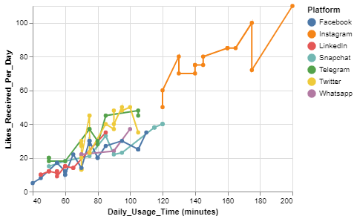
Figure 1.1 Social media platform rating

Slide 17
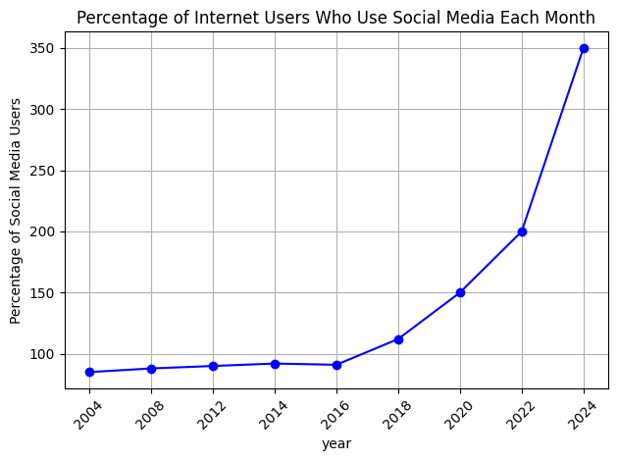
Figure 1.2 percentage of internet users

Slide 18
Figure 1.3: Measurement of analysis
Nodes | Degree Centrality | Closeness Centrality | Betweenness Centrality | Eigenvector Centrality
1 | 0.111111 | 0.31034 | 0.0 | 0.1941
2 | 0.111111 | 0.29032 | 0.0 | 0.06602
3 | 0.333333 | 0.4285 | 0.222222 | 0.4833
4 | 0.222222 | 0.39131 | 0.222222 | 0.16439
5 | 0.333333 | 0.529411 | 0.55555 | 0.52609
6 | 0.333333 | 0.42857 | 0.22222 | 0.48333
7 | 0.111111 | 0.310344 | 0.0 | 0.194107
8 | 0.222222 | 0.39130 | 0.22222 | 0.16439
9 | 0.111111 | 0.290322 | 0.0 | 0.06602059
15 | 0.333333 | 0.529411 | 0.66666 | 0.343319

Slide 19
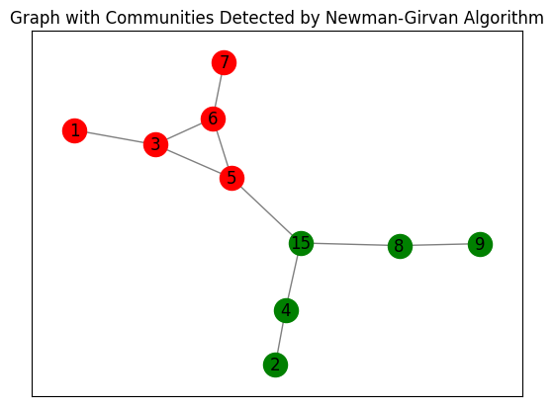
Figure 1.3 Graph of Girvan- Newman Algorithm of student during covid
Modularity: 0.395 This graph indicate that only two communities were created modularity score of 0.395 suggests a decent partition of the network into communities

Slide 20
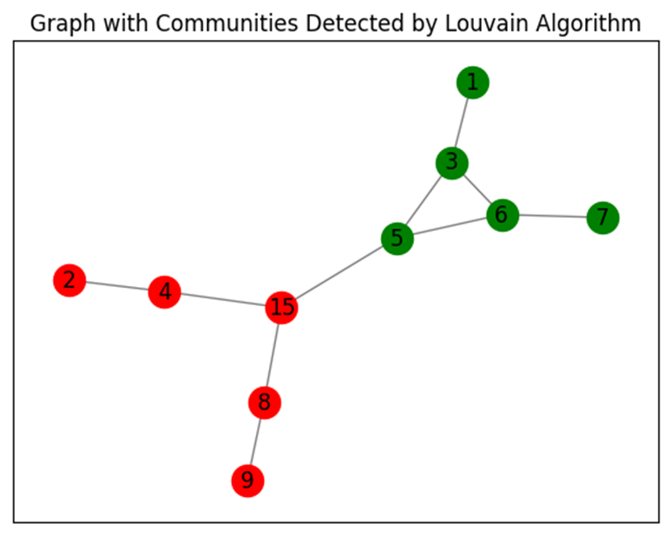
Figure 1.6 Graph of Louvain Algorithm
Modularity: 0.395 modularity value of 0.395 shows that nodes have been successfully categorized into communities that are less related to nodes in other communities but have strong internal connections

Slide 21
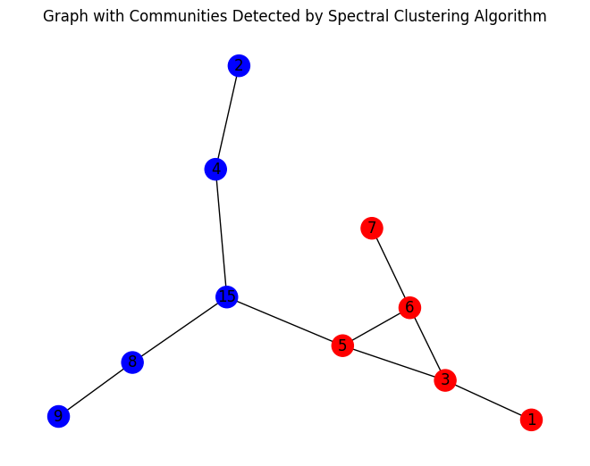
Figure 1.5 Graph of Clustering Algorithm
Modularity: 0.0992 This implies that the network's unique communities have not been successfully detected by the algorithm, and that the node-to-node connections are not highly concentrated inside groups. This low modularity score suggests that significant communities within the network have probably not been successfully recognized by the Spectral clustering algorithm.

Slide 22
Table 1.5 The community detection algorithm using modularity.
Community detection algorithm | modularity criteria
Girvan-Newman Algorithm | 0.395
Louvain Algorithm | 0.395
Spectral Clustering | 0.0992

Slide 23
Conclusion & Recommendations
According to our problem statement we have use all the method and we find that the Louvain Algorithm, with a modularity of 0.395, outperforms both Spectral Clustering and the Girvan-Newman Algorithm in terms of community detection, according to the modularity values presented.
This is as a result of the Louvain Algorithm achieving a greater modularity value, which shows that the network's community structure is stronger. With a modularity of 0.395, the Girvan-Newman Algorithm recognizes communities as well, if not more than the Louvain Algorithm. The algorithm's notable feature is, its capacity to detect communities through edge betweenness centrality, a gauge of an edge's significance in linking disparate segments of the network.

Slide 24
Challenges and future direction
Scalability One of the challenges in community detection is the scalability of algorithm for analysing large-scale networks with million of nodes and edges Dynamic network Future research aims to develop community detection methods that can adapt to changes in the network structure over time, know as dynamic network Multilayer network As the world keep on evolving and network become more complex , there is a need for community detection methods that can be able to handle interconnected layers of information

Slide 25
References
Alotaibi, N. and Rhouma, D., 2022. A review on community structures detection in time evolving social networks. Journal of King Saud University-Computer and Information Sciences, 34(8), pp.5646-5662.
Blei, D. M., Ng, A. Y., & Jordan, M. I. (2003) 'Latent Dirichlet Allocation', Journal of Machine Learning Research, 3, 993-1022
Blondel, V. D., Guillaume, J. L., Lambiotte, R., & Lefebvre, E. (2008) 'Fast unfolding of communities in large networks', Journal of Statistical Mechanics: Theory and Experiment, 2008(10), P10008
Cao, C., Ni, Q., & Zhai, Y. (2015). An Improved Collaborative Filtering Recommendation Algorithm Based on Community Detection in Social Networks. In Proceedings of the 2015 on Genetic and Evolutionary Computation Conference. ACM, 1-8. doi:10.1145/2739480.2754670. Newman, M. E., & Girvan, M. (2004) 'Finding and evaluating community structure in networks', Physical Review E, 69(2), 026113.
Holland, P. W., Laskey, K. B., & Leinhardt, S. (1983). Stochastic block models: First steps. Social Networks, 5, 109–137

